Slide 1

Pattern Classification
All materials in these slides were taken from
Pattern Classification (2nd ed) by R. O. Duda, P. E. Hart and D. G. Stork, John Wiley & Sons, 2000
with the permission of the authors and the publisher
Pattern Classification Chapter 2 (Part 2)

Slide 2
Chapter 2 (Part 2):
Bayesian Decision Theory
(Sections 2.3-2.5)
Minimum-Error-Rate Classification
Classifiers, Discriminant Functions and Decision Surfaces
The Normal Density
Pattern Classification Chapter 2 (Part 2)

Slide 3
Definitions of actions
Action α_{i :} assign the test sample to the i-th class
Seek a decision rule that minimizes the probability of error which is the error rate
Pattern Classification Chapter 2 (Part 2)

Slide 4
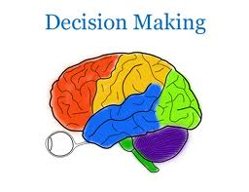

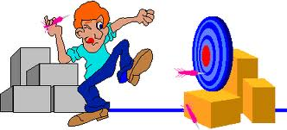
2.3 Minimum-Error-Rate Classification
Actions are decisions on classes
If action α_{i} is taken and the true state of nature is ω_{j} then:
the decision is correct if i = j and in error if i ≠ j
Pattern Classification Chapter 2 (Part 2)

Slide 5
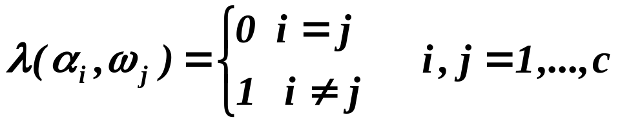
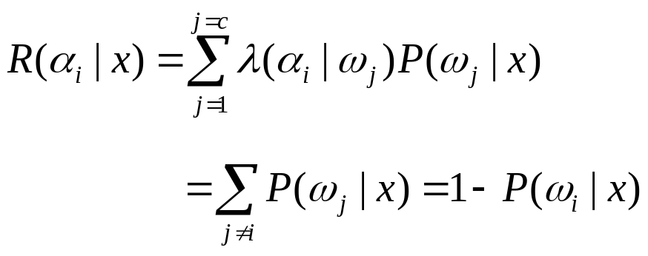
The loss function for above case is the zero-one loss function:
Therefore, the conditional risk is:
“The risk corresponding to this loss function is the average probability error”
Minimum-Error Bayesian Decision !
Pattern Classification Chapter 2 (Part 2)

Slide 6
Minimize the risk requires to maximize P(ω_{i} | x)
(since R(α_{i} | x) = 1 – P(ω_{i} | x))
For Minimum error rate
  Decide ω_{i} if P (ω_{i} | x) > P(ω_{j} | x) ∀j ≠ i
Pattern Classification Chapter 2 (Part 2)

Slide 7
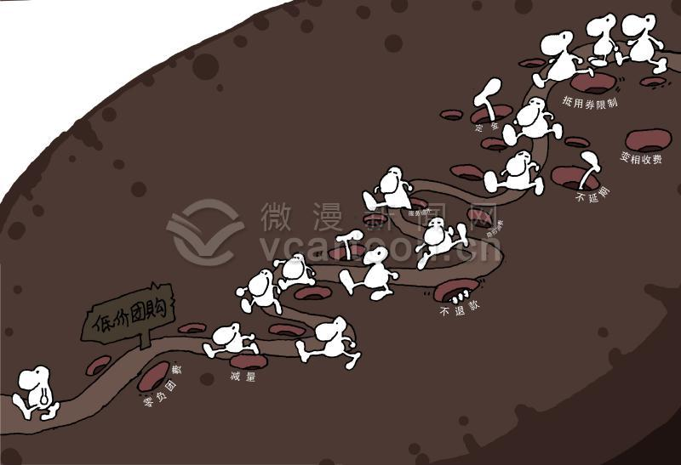


Minimum-Error and Maximum income in
expectation may be not optimal
How to minimize the risk ?
Pattern Classification Chapter 2 (Part 2)

Slide 8

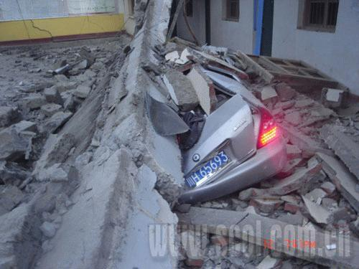
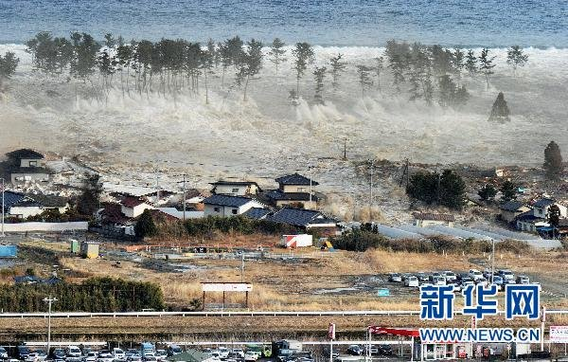

What should we do ?
How to define the risk (loss function) ?
How to obtain the minimum-risk
and make the decision safe enough ?
It is said that a typhoon may come here.
Should the fisherman work at a risk ?
A earthquake may occur at a probability of 50%.
Should we issue the earthquake forecast ?
Pattern Classification Chapter 2 (Part 2)
It is said that a seaquake may come at a probability of 60%. Should the residents leave ?

Slide 9
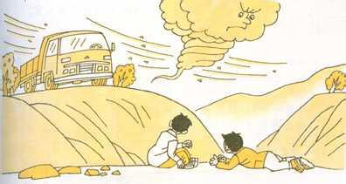
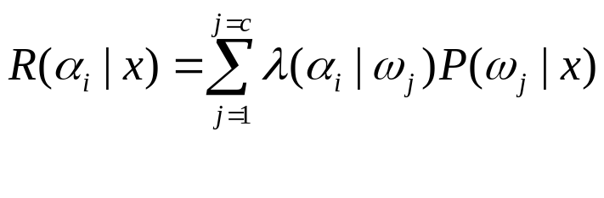



Minimum-risk decision
The conditional risk
can be defined in accordance with the real applications.
:The loss (cost) in the case where the class label is j but action
is adopted (the test sample is classified into the i–th class).
Pattern Classification Chapter 2 (Part 2)

Slide 10

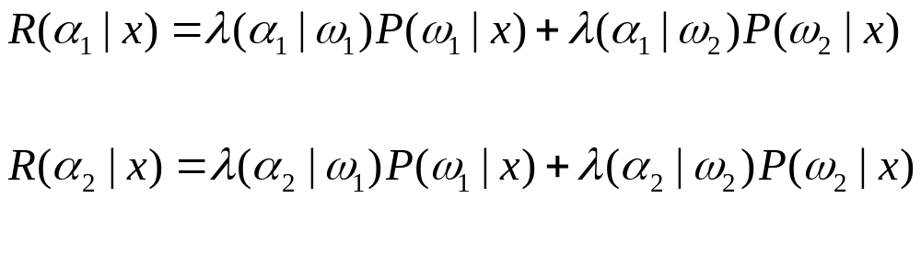


For two-class problem
If
Then the test sample is classified into the first class
Pattern Classification Chapter 2 (Part 2)

Slide 11
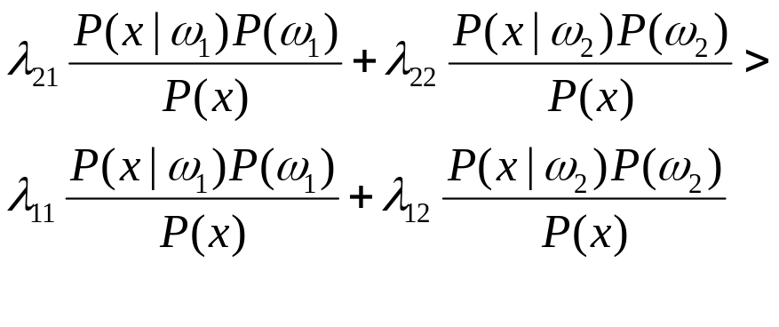
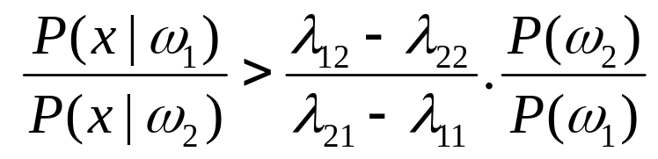
Minimum-risk decision
Pattern Classification Chapter 2 (Part 2)

Slide 12
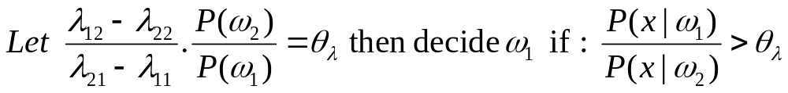
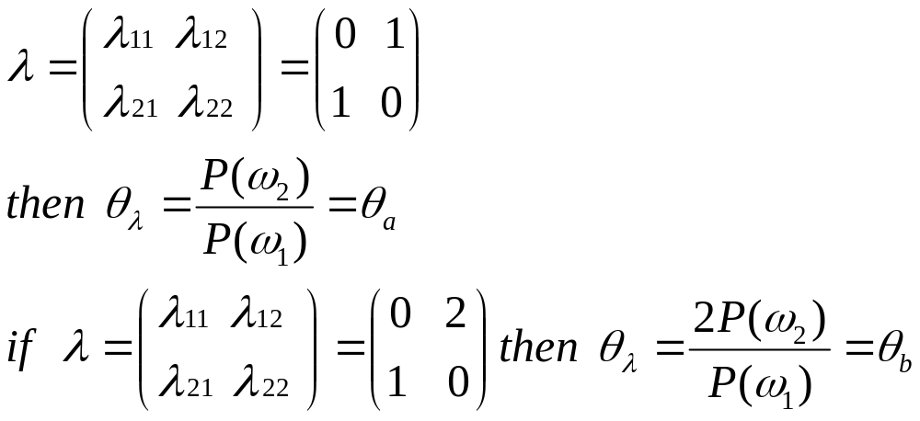
Regions of decision and zero-one loss function, therefore:
If λ is the zero-one loss function which means:
Pattern Classification Chapter 2 (Part 2)

Slide 13
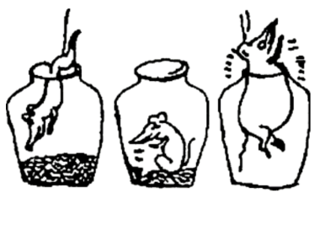


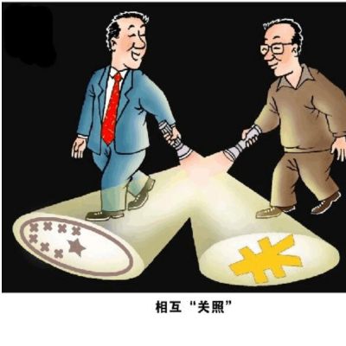
A high means a high loss (cost).
may be or be not zero.
An example: cancer diagnosis (+: 49%; - : 51%. How to reduce the risk ?)
An example: earthquake forecast
Pattern Classification Chapter 2 (Part 2)

Slide 14
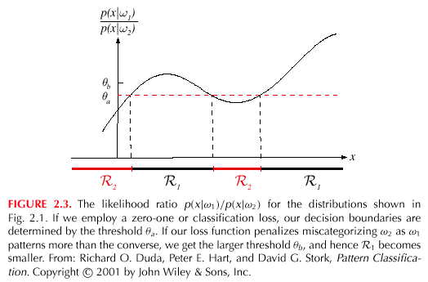
Pattern Classification Chapter 2 (Part 2)

Slide 15
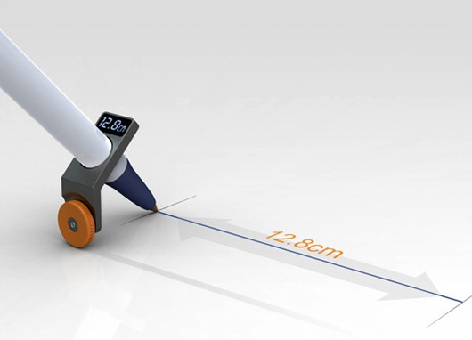


Example of Minimum-Error-Rate Classification
The error-rate is the sole criterion of classification
Pattern Classification Chapter 2 (Part 2)

Slide 16
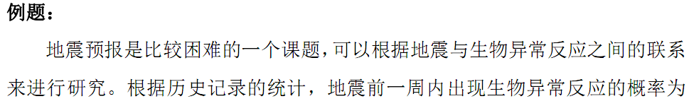
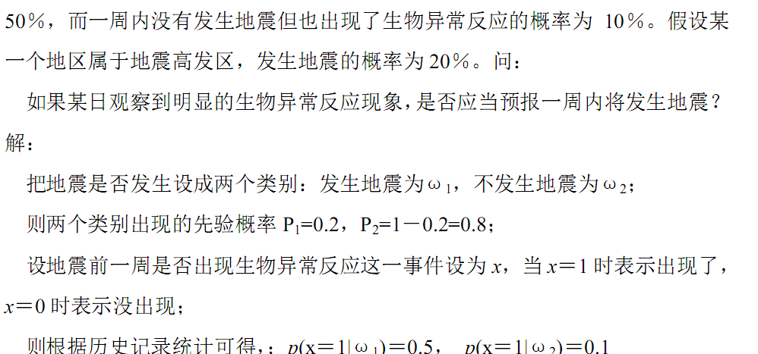
Pattern Classification Chapter 2 (Part 2)

Slide 17
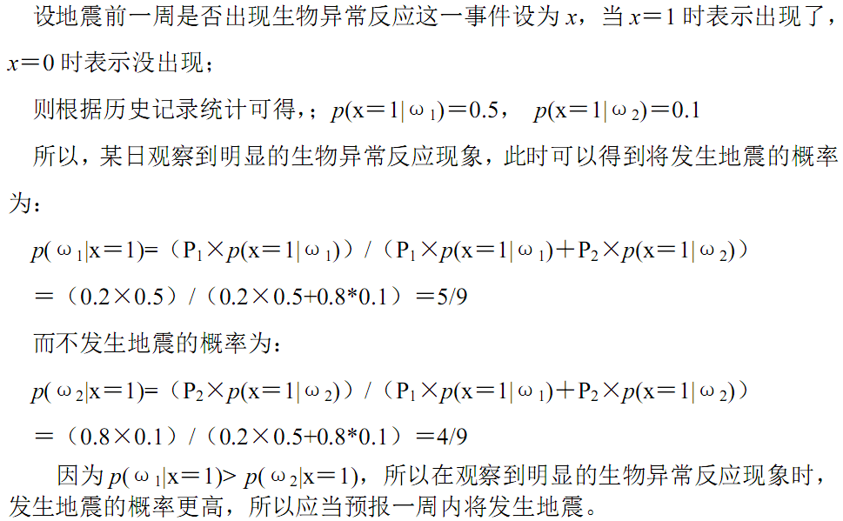
Pattern Classification Chapter 2 (Part 2)

Slide 18
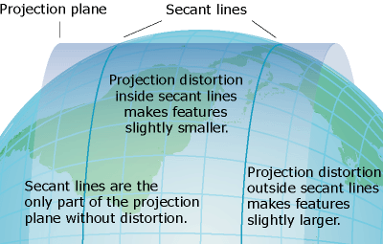

Disadvantage of Minimum-Error-Rate Classification
Minimum-Error might be not optimal.
The cost is lower than the tunnel
Minimum-risk is better !!
Pattern Classification Chapter 2 (Part 2)

Slide 19

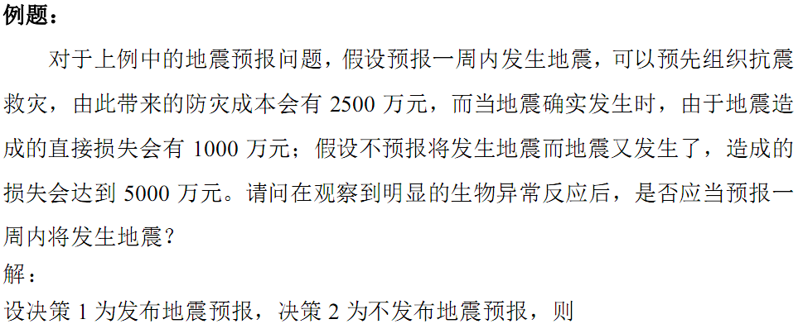
Minimum-risk
Pattern Classification Chapter 2 (Part 2)

Slide 20
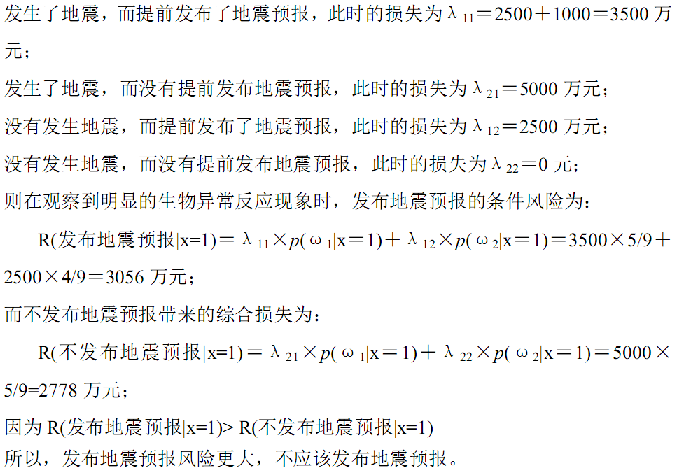

Minimum-risk
Pattern Classification Chapter 2 (Part 2)

Slide 21
2.4 Classifiers, Discriminant Functions and Decision Surfaces
The multi-category case
  Set of discriminant functions g_{i}(x), i = 1,…, c
  The classifier assigns a feature vector x to class ω_{i}
  if: g_{i}(x) > g_{j}(x) ∀j ≠ i
Pattern Classification Chapter 2 (Part 2)

Slide 22
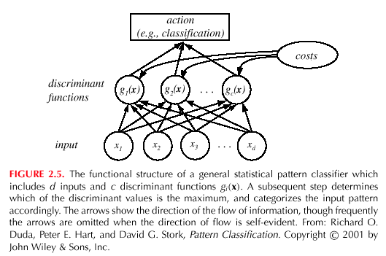
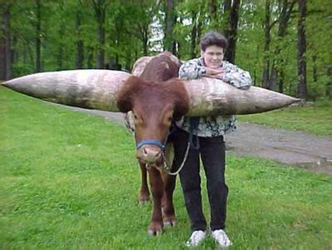
Pattern Classification Chapter 2 (Part 2)

Slide 23

For the minimum risk case
Let g_{i}(x) = - R(α_{i} | x)
(max. discriminant corresponds to min. risk!)
For the minimum error rate case, we take
  g_{i}(x) = P(ω_{i} | x)
(max. discrimination corresponds to max. posterior!)
g_{i}(x) ≡ p(x | ω_{i}) P(ω_{i})
g_{i}(x) = ln p(x | ω_{i}) + ln P(ω_{i})
(ln: natural logarithm!)
Pattern Classification Chapter 2 (Part 2)

Slide 24

Feature space divided into c decision regions
if g_{i}(x) > g_{j}(x) ∀ j ≠ i then x is in R_{i}
(R_{i} means to assign x to ω_{i})
The two-category case
  A classifier is a “dichotomizer” that has two discriminant functions g₁ and g₂
  Let g(x) ≡ g₁(x) – g₂(x)
  Decide ω₁ if g(x) > 0 ; Otherwise decide ω₂
Pattern Classification Chapter 2 (Part 2)

Slide 25
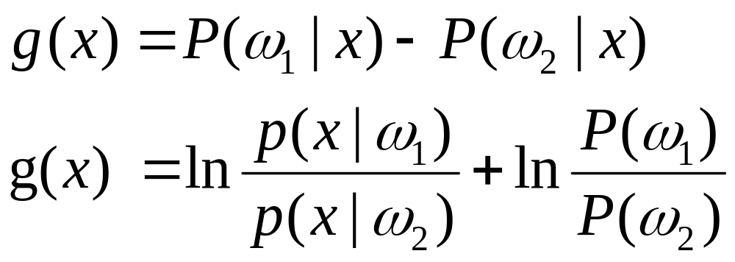

  The computation of g(x)
Pattern Classification Chapter 2 (Part 2)

Slide 26
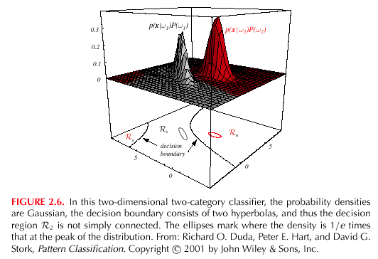
Pattern Classification Chapter 2 (Part 2)

Slide 27


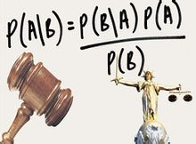

Difficulties of Bayesian decision
It’s not easy to obtain the probability (prior and conditional probability)
Pattern Classification Chapter 2 (Part 2)

Slide 28
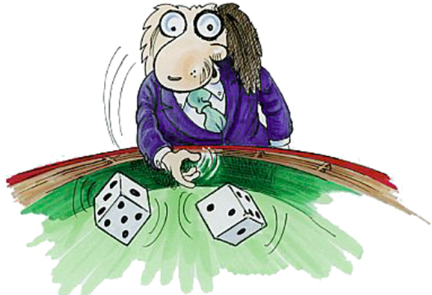

To assume that the conditional probability satisfies the normal distributions is a basic way.
The real-world verifies that the normal distributions is really consistent with the true distribution
Pattern Classification Chapter 2 (Part 2)

Slide 29

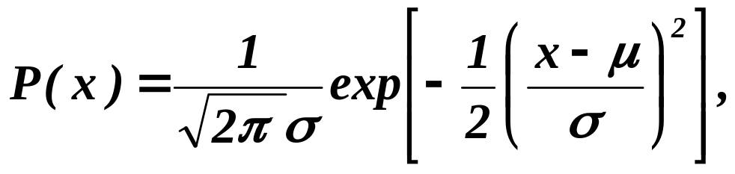
2.5 The Normal Density
Univariate density
  Continuous density
  A lot of processes are asymptotically Gaussian
  Handwritten characters, speech sounds are ideal or prototype corrupted by random process (central limit theorem)
Where:
μ = mean (or expected value) of x
σ² = expected squared deviation or variance
Pattern Classification Chapter 2 (Part 2)

Slide 30
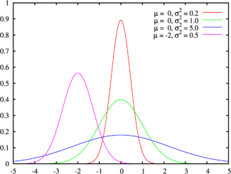
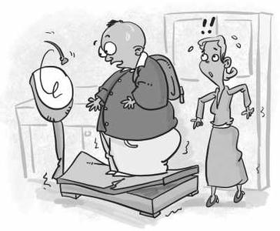
Examples of normal distributions
Pattern Classification Chapter 2 (Part 2)

Slide 31
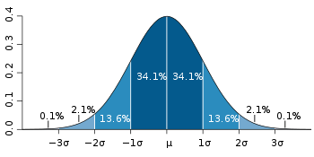
The 68-95-99.7 rule
Pattern Classification Chapter 2 (Part 2)

Slide 32
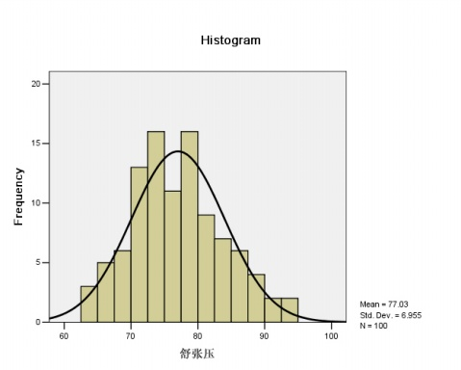
Examples in the real world
Pattern Classification Chapter 2 (Part 2)

Slide 33
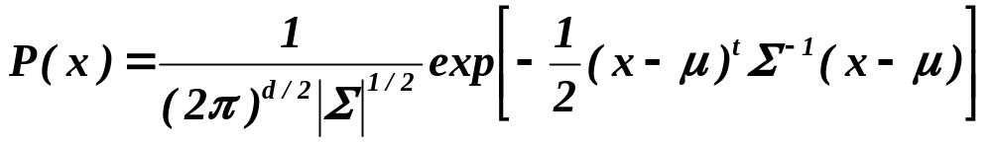

Multivariate density
  Multivariate normal density in d dimensions is:
where:
x = (x₁, x₂, …, x_{d})^{t} (t stands for the transpose vector form)
μ = (μ₁, μ₂, …, μ_{d})^{t} mean vector
Σ = d*d covariance matrix
|Σ| and Σ⁻¹ are determinant and inverse respectively
Pattern Classification Chapter 2 (Part 2)

Slide 34
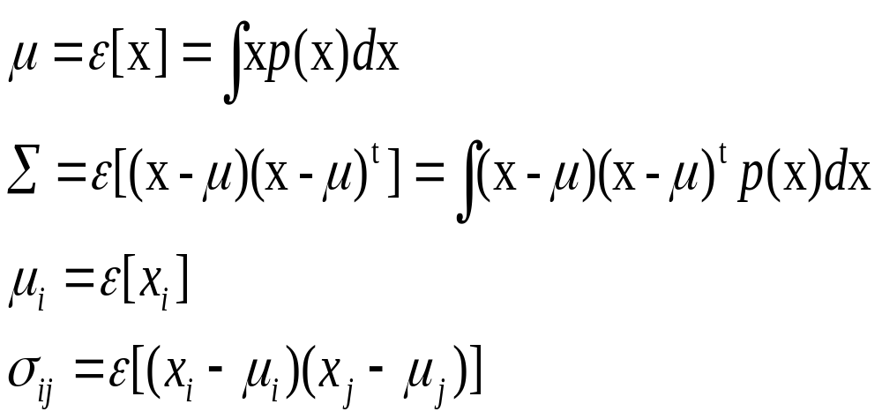
Pattern Classification Chapter 2 (Part 2)

Slide 35

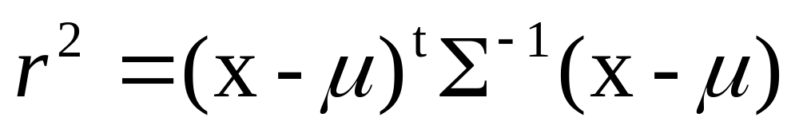
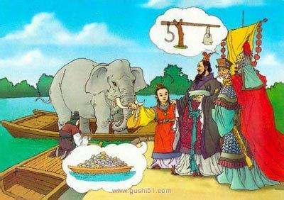
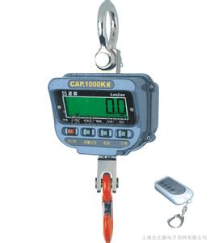
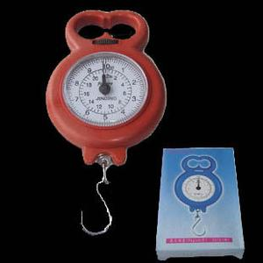
Mahalanobis distance from x to
Mahalanobis distance is widely sued in pattern recognition
Pattern Classification Chapter 2 (Part 2)

Slide 36
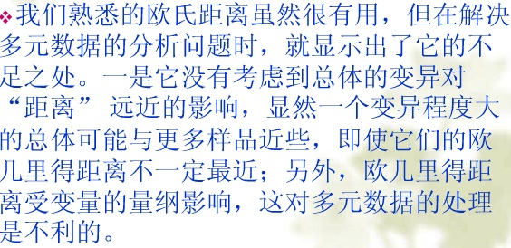

Pattern Classification Chapter 2 (Part 2)

Slide 37
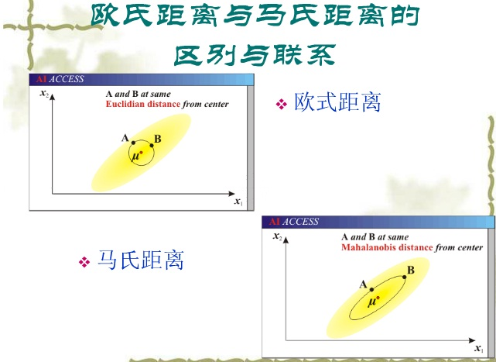
Pattern Classification Chapter 2 (Part 2)

